Slide 1
Tutorial 6
Factor Analysis & SEM
BUAD 405 — Applied Econometrics | Summer '26

Slide 2
Where this tutorial is going
1
Inspect the survey
2
Factor Analysis (FA)
3
SEM
4
Mediation preview
Read the wording behind account_fin, fin2, fin8... before touching code.
Do 8 binary items collapse into 2 meaningful latent constructs?
Split into a measurement model and a structural path between the two constructs.
Set up (not estimate) a 3-variable mediation chain for Assignment 3.
Learning goal: read loadings, choose dimensions, link two latent constructs.
BUAD 405 | Tutorial 6

Slide 3
Eight survey indicators
Code | Survey meaning
account_fin | Has an account at a financial institution
fin2 | Has a debit / ATM card
fin8 | Typically keeps money in the account
fin9a | Received account-balance information
account_mob | Has a mobile money account
fin25e2 | Made an in-store digital purchase
fin26a | Made a bill payment by phone / computer
fin26b | Made an online purchase
- One row = one respondent — not one firm, not one country.
- The survey wording defines the variable; the short column name (e.g. fin8) does not.
- yes/no items are coded 1 = Yes, 2 = No.
- Blank values are often skip patterns from the questionnaire, not random missing data.
Financial inclusion is broader than owning an account. Findex lets us check whether people also access and actively use digital financial tools.
Ownership · behaviour · access · use · perceptions — not accounting ratios.
BUAD 405 | Tutorial 6

Slide 4
Correlating binary items
tetrachoric(items)$rho
Example: Physics Exam (100 Students)
Question A (Easy): "Define velocity." → 79 Pass / 21 Fail
Question B (Hard): "Calculate quantum momentum." → 31 Pass / 69 Fail
30 passed both, 20 failed both, 49 passed A but failed B, 1 failed A but passed B
Pearson Correlation (r = 0.292): Misleadingly low. Penalizes the 49-student gap caused purely by question difficulty.
Tetrachoric Correlation (rho = 0.766): Accurately captures that almost every student who passed the hard question also passed the easy one.
Pearson penalizes this mismatch heavily and outputs a weak correlation of $0.292$, falsely suggesting the two questions have very little to do with each other—even though nearly every single student who solved the hard question also solved the easy one.
Standard Pearson correlation compares raw 1/0 values directly.
If two questions have very different difficulty levels, Pearson heavily penalizes the mismatch and underestimates their relationship. \
Tetrachoric correlation assumes a smooth, continuous unobserved trait (e.g., Physics Ability) exists behind binary outcomes and estimates the true underlying correlation.
R: Rtet <- tetrachoric(items)$rho
BUAD 405 | Tutorial 6

Slide 5
The factor analysis model
itemⱼ = λⱼ · Factor + εⱼ
itemⱼ
the observed answer to survey item j (e.g., fin26b, online purchase)
Factor
the unobserved latent construct (e.g., "Digital Financial Activity")
λⱼ (loading)
how strongly item j reflects the factor — this is what FA estimates
εⱼ
the part of item j the factor does NOT explain (its uniqueness)
BUAD 405 | Tutorial 6

Slide 6
What are FA outputs (important ones)
Eigenvalues
2
Loadings
Communalities
1
3
the tetrachoric correlation matrix we created assumes a hidden trait.
Eigenvalues measure the total variance (direction & strength) captured by each of these hidden traits.
An eigenvalue greater than 1.0 means that specific factor explains more information than a single standalone survey question.
a correlation-like number between an observed item and a hidden factor
i.e how strongly that one survey answer moves together with the invisible construct.
Higher loadings (closer to 1.0 or -1.0) mean the survey answer is a powerful indicator of that invisible construct.
the total percentage of a single survey question's variance explained by all extracted factors combined.
Final communalities reveal how much of that question's unique shape was successfully captured by the final model.
How many factors to keep?
Eigenvalues / variance explained
Scree plot
fa.parallel(Rtet, n.obs = nrow(items),
fa = "fa", fm = "minres")
Plots eigenvalues in decreasing order.
Look for the "elbow" — the point where extra factors stop adding much explanatory power.
For this dataset, two factors is the expected, defensible answer — matching the two-construct story the tutorial builds toward (Formal Account Engagement, Digital Financial Activity).
Parallel analysis
Compares your real eigenvalues to eigenvalues from random, uncorrelated data. Keep a factor only if it beats its random-data counterpart.
We keep this simple: visual plot only, not a formal statistical test.
BUAD 405 | Tutorial 6

Slide 7
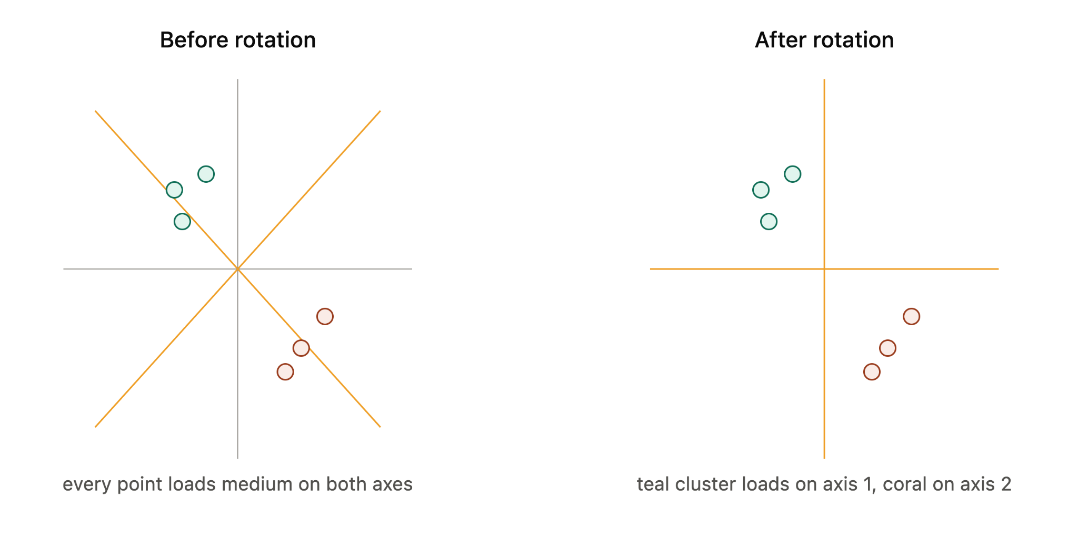
Reading the rotated loadings
 | Factor 1 | Factor 2
account_fin | .78 | .05
debit_card | .71 | .10
keeps_money | .65 | -.02
balance_information | .58 | .14
mobile_money | .08 | .74
store_purchase | .02 | .69
bill_payment | -.05 | .66
online_purchase | .11 | .72
Rotation doesn't change the model's fit at all — it just spins the factor axes in space to make the loadings easier to read: pushing them toward either near-1 (clearly belongs) or near-0 (clearly doesn't), instead of a smear of medium values across every factor.
Grouping rule
Items in gold load ≥ .30 on that factor — group them together.
Factor 1 groups account_fin, debit_card, keeps_money, balance_information → candidate label: “Formal Account Engagement.”
Factor 2 groups mobile_money, store_purchase, bill_payment, online_purchase → candidate label: “Digital Financial Activity.”
Flag any item with no loading ≥ .30, or with strong loadings on both factors.
BUAD 405 | Tutorial 6

Slide 8
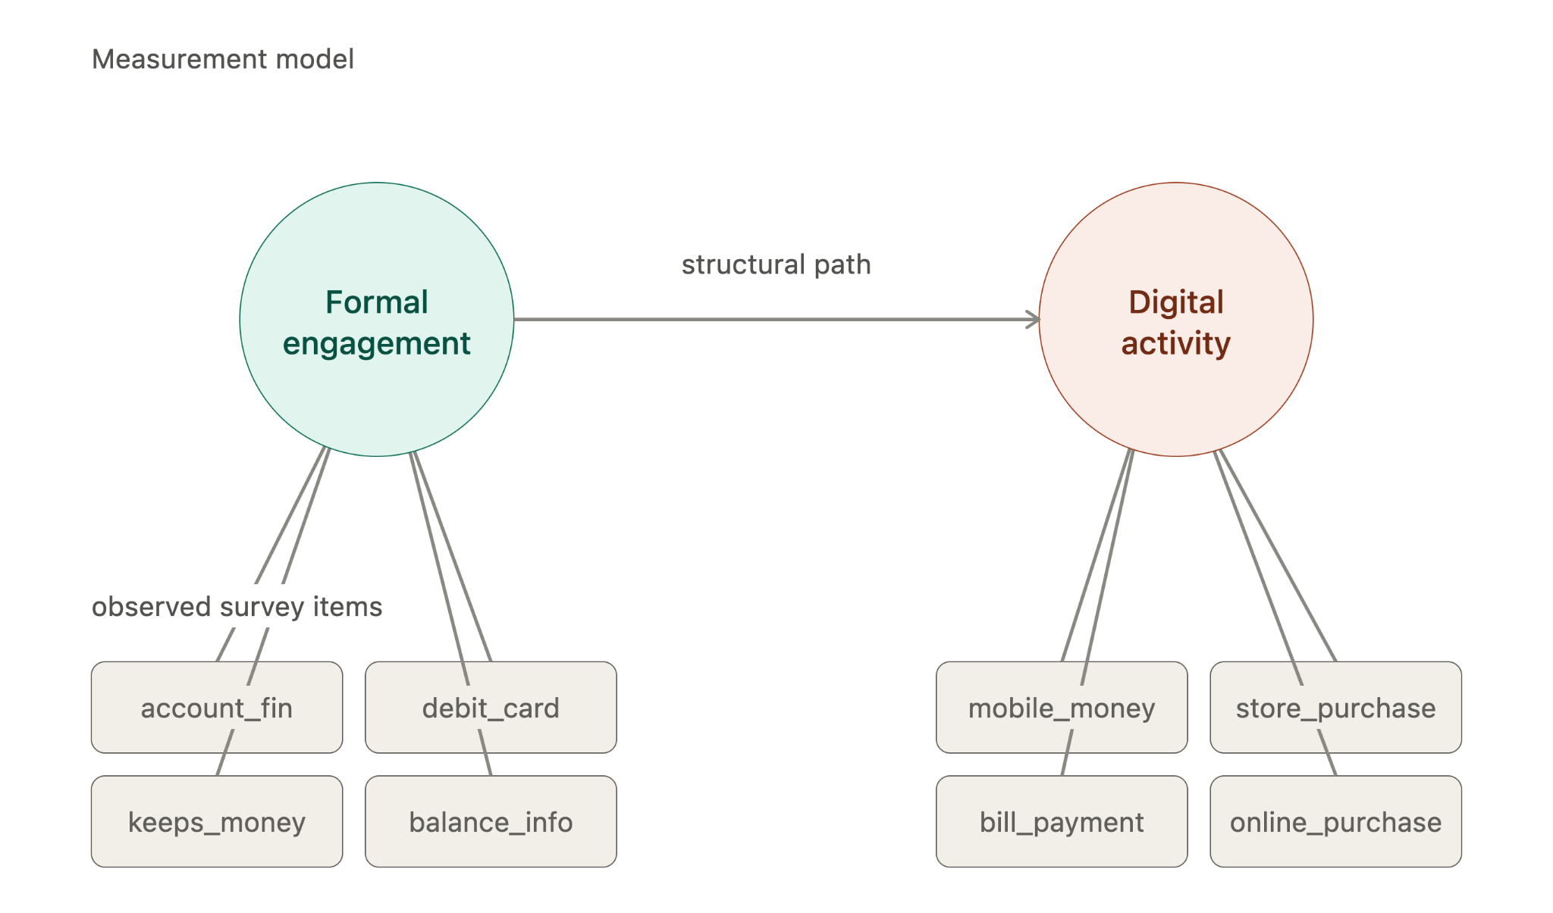
SEM: two models in one
Measurement model
How strongly each observed survey item measures its latent construct — the same loadings idea as FA, now estimated jointly with the structural path.
FormalEngagement =~ account_fin + ...
=~ “is measured by”
"Estimate the invisible things, then test the relationship between them."
Structural model
- Bottom row → circles (measurement model): your survey answers are evidence of a construct, not the construct itself. Arrows point up because the item reflects the construct — not the reverse.
- Circle → circle (structural model): this is the actual research question — does Formal Engagement predict Digital Activity?
- "Loading" = how good a symptom is this item? High loading on account_fin → having an account is a strong tell you're formally engaged. Low loading → weak, noisy signal.
- The structural arrow is just a regression — same logic as y ~ x, except both sides are estimated constructs instead of raw columns.
The direction and strength of the relationship between the two latent constructs themselves.
DigitalActivity ~ FormalEngagement
~ “is regressed on”
Keep the language associational: cross-sectional survey data does not by itself establish causality.
R: sem(model, data = items, ordered = names(items), estimator = "WLSMV")
BUAD 405 | Tutorial 6

Slide 9
Interpreting the SEM output
Measurement table
Structural table
R²
Fit index
out[out$op == "=~", ]
out[out$op == "~", ]
inspect(fit, "r2")
fitMeasures(fit, c("cfi","rmsea"))
Are the observed items loading meaningfully (large, significant) on their intended construct?
Sign and size of FormalEngagement → DigitalActivity. Positive & significant = they move together.
Share of variance in DigitalActivity explained by FormalEngagement. Familiar, but not a fit test.
One overall check: CFI closer to 1 is better; RMSEA closer to 0 is better.
R² alone is not a test of overall model fit — pair it with CFI or RMSEA.
BUAD 405 | Tutorial 6

Slide 10
Lead-in: mediation preview
What variable could explain how a respondent characteristic becomes associated with digital financial activity?
Indirect effect = a × b
Education
a
Formal Account
Engagement
b
Digital Financial
Activity
direct effect: Education → Digital Financial Activity (with mediator included)
Total effect = direct + indirect
If the indirect effect (a×b) is large relative to the total = "education matters mainly because it gets people into the formal financial system; if you skip that step, the effect on digital activity mostly vanishes."
If the direct effect stays large even after including the mediator, formal engagement isn't the main explanation — something else is doing the work.

